Slide 1
Module 6

Slide 2
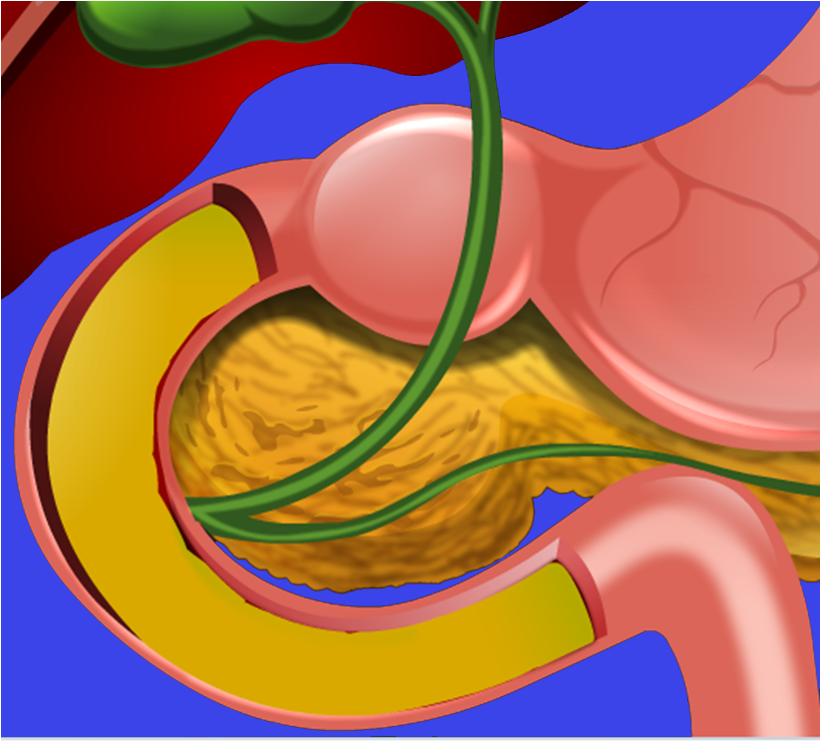
Now the food enters the small intestine.

Slide 3
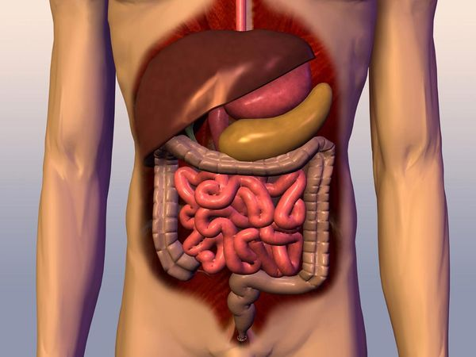
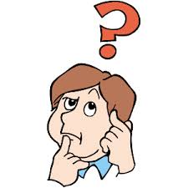
SMALL INTESTINE is the longest part of the alimentary canal
Belly
Fitted into a compact space in the belly by extensive coiling
5-6 meters
Small intestine
Abdomen
Longer than the large intestine
Twists and turns
Why is it called small intestine ?
Because it has smaller diameter
Carbohydrates, fats and proteins are fully digested in the small intestine

Slide 4
Digestion of food in the small intestine requires alkaline medium
So the food received from the stomach has to be first made alkaline.
Now how does it happen?

Slide 6
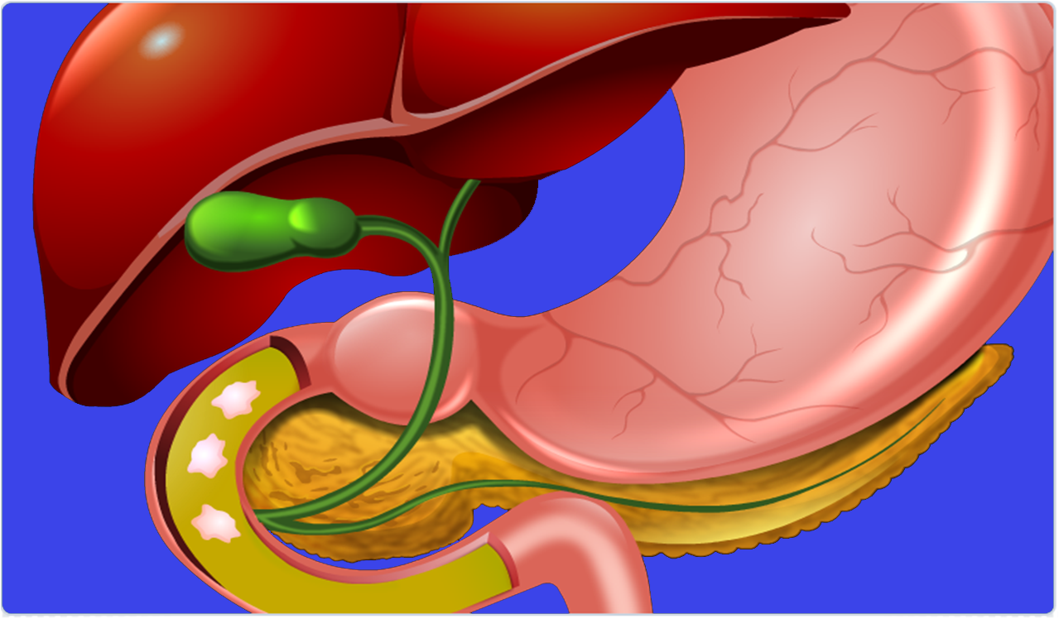
Whenever, food enters the small intestine, the gall bladder releases bile juice into it through a duct.
Liver, the largest gland in the body secretes bile juice.
This bile juice is stored in the gall bladder.
Liver
Gall bladder
Stomach
Pancreas

Slide 7
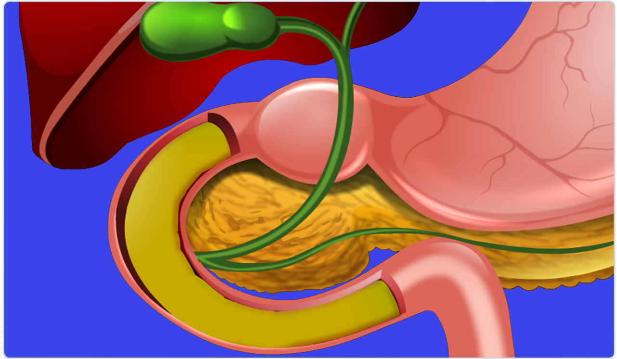
Now the pancreas secrete pancreatic juice.
Bile makes the food alkaline.
It also breaks the large fat globules into smaller ones, this increases the action of enzymes.
The bile and pancreatic juice enter the small intestine through a common duct.
This is called as Emulsification of fats
Alkaline pH
Pancreas
Fat globules
common duct.

Slide 8
The pancreatic juice has 3 digestive enzymes :
Amino acids
The first one is Trypsin :
Fatty acids
Pancreatic amylase Digests carbohydrates into glucose
Proteins
Fats
Trypsin
Lipase
The Third one is Pancreatic amylase
The second one is Lipase :
Glucose
Lipase digests fats into fatty acid
Trypsin digests proteins into amino acids
Pancreatic amylase
Carbohydrates

Slide 9
So finally,
i.e.
Complex food
Carbohydrates
(Starch)
Fats
Proteins
Are converted to
i.e.
Simple food
Glucose
Fatty
Acids
Amino
Acids
Thus the food is completely digested in the small intestine.

Slide 10
Thank You

